Slide 1
Quadrilateral Angles
From nRich Strange Rectangle
384

Slide 2




Quadrilateral Angles
$$C \left(1,5\right)$$
(Not to scale)
$$B \left(7,3\right)$$
$$\left(0,2\right) D$$
$$A \left(1,0\right)$$
Determine the angles (exactly) in the quadrilateral.

Slide 3






Quadrilateral Angles
$$C \left(1,5\right)$$
$$\sqrt{2^{2}+{\left(−6\right)}^{2}}=2\sqrt{10}$$
$$\sqrt{3^{2}+1^{2}}=\sqrt{10}$$
$$5$$
$$B \left(7,3\right)$$
$$5\sqrt{2}$$
$$\left(0,2\right) D$$
$$\sqrt{3^{2}+6^{2}}=3\sqrt{5}$$
$$\sqrt{2^{2}+{\left(−1\right)}^{2}}=\sqrt{5}$$
$$A \left(1,0\right)$$
You could start by determining all the lengths.

Slide 4



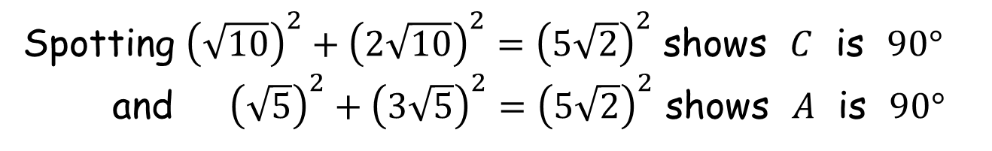

Quadrilateral Angles
$$C \left(1,5\right)$$
$$2\sqrt{10}$$
$$\sqrt{10}$$
$$5$$
$$B \left(7,3\right)$$
$$5\sqrt{2}$$
$$\left(0,2\right) D$$
$$3\sqrt{5}$$
$$\sqrt{5}$$
$$A \left(1,0\right)$$
Spotting ${\left(\sqrt{10}\right)}^{2}+{\left(2\sqrt{10}\right)}^{2}={\left(5\sqrt{2}\right)}^{2}$ shows $C$ is $90°$
and ${\left(\sqrt{5}\right)}^{2}+{\left(3\sqrt{5}\right)}^{2}={\left(5\sqrt{2}\right)}^{2}$ shows $A$ is $90°$

Slide 5
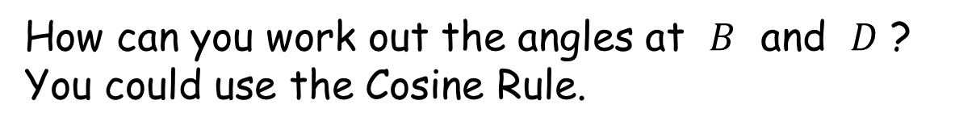
Quadrilateral Angles
$$C \left(1,5\right)$$
$$2\sqrt{10}$$
$$\sqrt{10}$$
$$5$$
$$B \left(7,3\right)$$
$$\left(0,2\right) D$$
$$3\sqrt{5}$$
$$\sqrt{5}$$
$$A \left(1,0\right)$$
How can you work out the angles at $B$ and $D$ ?
You could use the Cosine Rule.

Slide 6
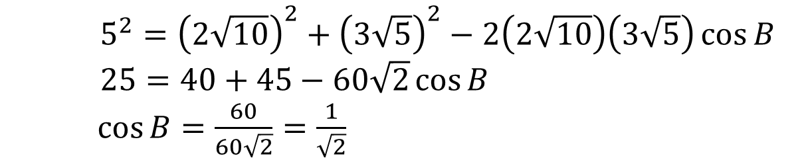


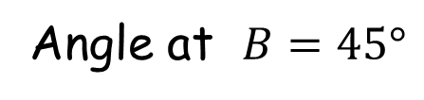
Quadrilateral Angles
$$C \left(1,5\right)$$
$$2\sqrt{10}$$
$$B \left(7,3\right)$$
$$5$$
$$3\sqrt{5}$$
$$A \left(1,0\right)$$
$5^{2}={\left(2\sqrt{10}\right)}^{2}+{\left(3\sqrt{5}\right)}^{2}−2\left(2\sqrt{10}\right)\left(3\sqrt{5}\right)\cos{B}$
$25=40+45−60\sqrt{2}\cos{B}$
$\cos{B}=\frac{60}{60\sqrt{2}}=\frac{1}{\sqrt{2}}$
Angle at $B=45°$

Slide 7

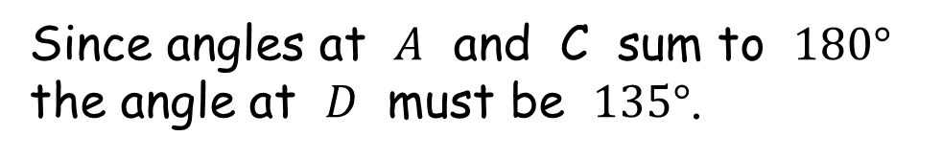
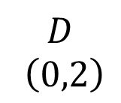
Quadrilateral Angles
$$C \left(1,5\right)$$
(Not to scale)
$$B \left(7,3\right)$$
$$45°$$
$$D$$
$$\left(0,2\right)$$
$$A \left(1,0\right)$$
Since angles at $A$ and C sum to $180°$
the angle at $D$ must be $135°$.

Slide 8

Quadrilateral Angles
$$C \left(1,5\right)$$
(Not to scale)
How was it possible to produce so many different worksheets with the same angles?
$$B \left(7,3\right)$$
$$45°$$
$$D$$
$$\left(0,2\right)$$
$$135°$$
$$A \left(1,0\right)$$
Determine the angles in the quadrilateral.

Slide 9






Quadrilateral Angles
$$y\left(x−y\right)$$
$$x\left(x+y\right)$$
$$x\left(x−y\right)$$
$$y\left(x+y\right)$$
$$y\left(x+y\right)$$
$$x\left(x−y\right)$$
$$y\left(x−y\right)$$
$$x\left(x+y\right)$$
Various values of $x$ and $y$ were used to create the coordinates on the worksheets.

Slide 11
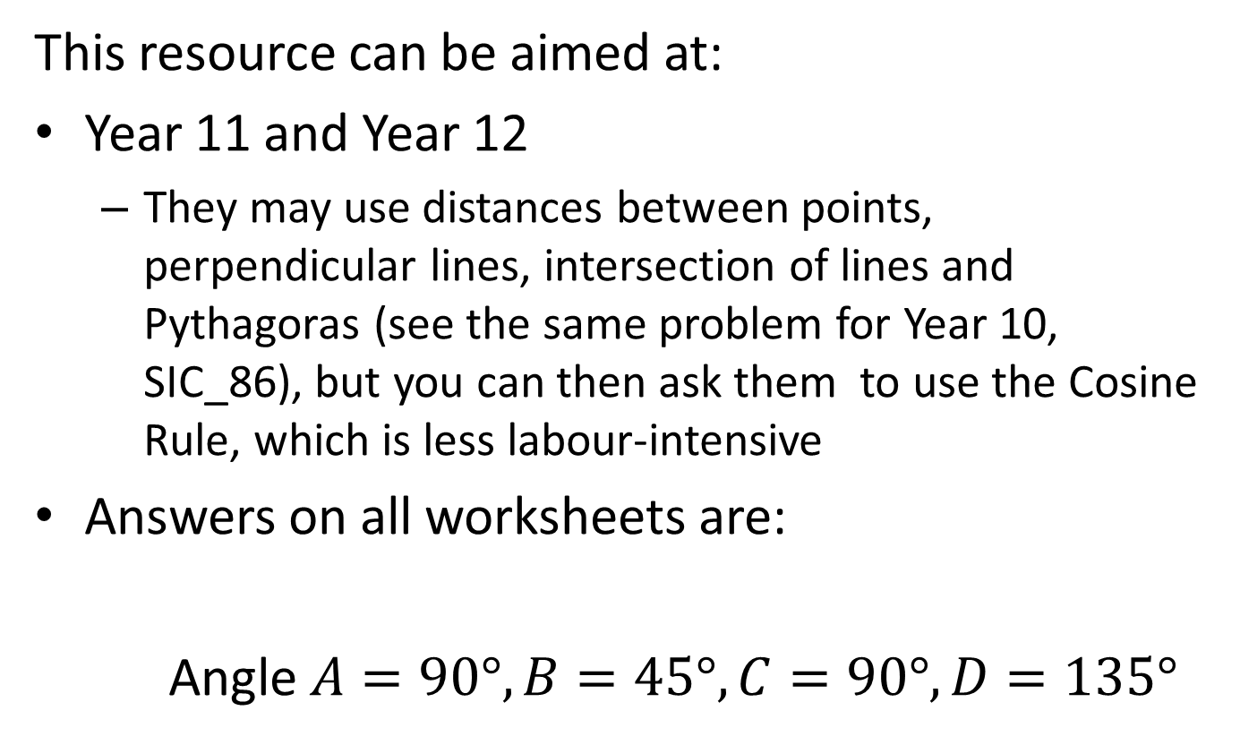
Note to Teacher
This resource can be aimed at:
Year 11 and Year 12
They may use distances between points, perpendicular lines, intersection of lines and Pythagoras (see the same problem for Year 10, SIC_86), but you can then ask them to use the Cosine Rule, which is less labour-intensive
Answers on all worksheets are:
Angle $A=90°, B=45°, C=90°, D=135°$

Slide 12
RESOURCES

Slide 13

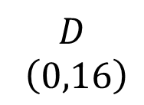


Quadrilateral Angles
SIC_87
$$C \left(8,40\right)$$
(Not to scale)
$$B \left(56,24\right)$$
$$D$$
$$\left(0,16\right)$$
$$A \left(8,0\right)$$
A
Determine the angles in the quadrilateral.
Notes:
X=6, y=2

Slide 14

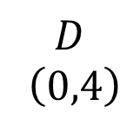


Quadrilateral Angles
SIC_87
$$C \left(2,10\right)$$
(Not to scale)
$$B \left(14,6\right)$$
$$D$$
$$\left(0,4\right)$$
$$A \left(2,0\right)$$
B
Determine the angles in the quadrilateral.
Notes:
X=3, y=1

Slide 15

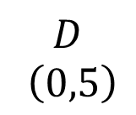


Quadrilateral Angles
SIC_87
$$C \left(3,17\right)$$
(Not to scale)
$$B \left(23,12\right)$$
$$D$$
$$\left(0,5\right)$$
$$A \left(3,0\right)$$
C
Determine the angles in the quadrilateral.
Notes:
X=4, y=1

Slide 16
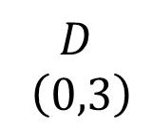


Quadrilateral Angles
SIC_87
$$C \left(2,13\right)$$
(Not to scale)
$$B \left(17,10\right)$$
$$D$$
$$\left(0,3\right)$$
$$A \left(2,0\right)$$
D
Determine the angles in the quadrilateral.
Notes:
X=3, y=2

Slide 17

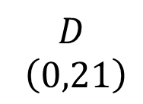


Quadrilateral Angles
SIC_87
$$C \left(12,65\right)$$
(Not to scale)
$$B \left(89,44\right)$$
$$D$$
$$\left(0,21\right)$$
$$A \left(12,0\right)$$
E
Determine the angles in the quadrilateral.
Notes:
X=7, y=4

Slide 18

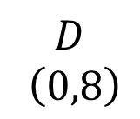


Quadrilateral Angles
SIC_87
$$C \left(4,20\right)$$
(Not to scale)
$$B \left(28,12\right)$$
$$D$$
$$\left(0,8\right)$$
$$A \left(4,0\right)$$
F
Determine the angles in the quadrilateral.
Notes:
X=4, y=2

Slide 19



Quadrilateral Angles
SIC_87
$$C \left(6,50\right)$$
(Not to scale)
$$B \left(62,42\right)$$
$$D$$
$$\left(0,8\right)$$
$$A \left(6,0\right)$$
G
Determine the angles in the quadrilateral.
Notes:
X=7, y=4

Slide 20


Quadrilateral Angles
SIC_87
$$C \left(3,25\right)$$
(Not to scale)
$$B \left(31,21\right)$$
$$D$$
$$\left(0,4\right)$$
$$A \left(3,0\right)$$
H
Determine the angles in the quadrilateral.
Notes:
X=4, y=3

Slide 21
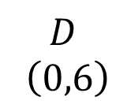


Quadrilateral Angles
SIC_87
$$C \left(4,26\right)$$
(Not to scale)
$$B \left(34,20\right)$$
$$D$$
$$\left(0,6\right)$$
$$A \left(4,0\right)$$
I
Determine the angles in the quadrilateral.
Notes:
X=5, y=1

Slide 22
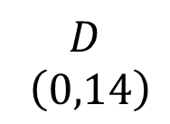


Quadrilateral Angles
SIC_87
$$C \left(6,29\right)$$
(Not to scale)
$$B \left(41,15\right)$$
$$D$$
$$\left(0,14\right)$$
$$A \left(6,0\right)$$
J
Determine the angles in the quadrilateral.
Notes:
X=5, y=2

Slide 23
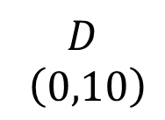


Quadrilateral Angles
SIC_87
$$C \left(6,34\right)$$
(Not to scale)
$$B \left(46,24\right)$$
$$D$$
$$\left(0,10\right)$$
$$A \left(6,0\right)$$
K
Determine the angles in the quadrilateral.
Notes:
X=5, y=3

Slide 24


Quadrilateral Angles
SIC_87
$$C \left(4,41\right)$$
(Not to scale)
$$B \left(49,36\right)$$
$$D$$
$$\left(0,5\right)$$
$$A \left(4,0\right)$$
L
Determine the angles in the quadrilateral.
Notes:
X=5, y=4

Slide 25
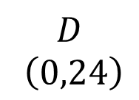

Quadrilateral Angles
SIC_87
$$C \left(8,40\right)$$
(Not to scale)
$$D$$
$$\left(0,24\right)$$
$$B \left(56,16\right)$$
$$A \left(8,0\right)$$
M
Determine the angles in the quadrilateral.
Notes:
X=6, y=2

Slide 26
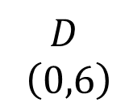

Quadrilateral Angles
SIC_87
$$C \left(2,10\right)$$
(Not to scale)
$$D$$
$$\left(0,6\right)$$
$$B \left(14,4\right)$$
$$A \left(2,0\right)$$
N
Determine the angles in the quadrilateral.
Notes:
X=3, y=1

Slide 27
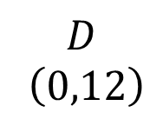

Quadrilateral Angles
SIC_87
$$C \left(3,17\right)$$
(Not to scale)
$$D$$
$$\left(0,12\right)$$
$$B \left(23,5\right)$$
$$A \left(3,0\right)$$
O
Determine the angles in the quadrilateral.
Notes:
X=4, y=1

Slide 28

Quadrilateral Angles
SIC_87
$$C \left(2,13\right)$$
(Not to scale)
$$D$$
$$\left(0,10\right)$$
$$B \left(17,3\right)$$
$$A \left(2,0\right)$$
P
Determine the angles in the quadrilateral.
Notes:
X=3, y=2

Slide 29
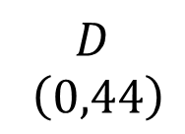

Quadrilateral Angles
SIC_87
$$C \left(12,65\right)$$
(Not to scale)
$$D$$
$$\left(0,44\right)$$
$$B \left(89,21\right)$$
$$A \left(12,0\right)$$
Q
Determine the angles in the quadrilateral.
Notes:
X=7, y=4

Slide 30
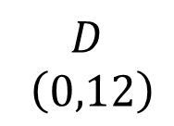

Quadrilateral Angles
SIC_87
$$C \left(4,20\right)$$
(Not to scale)
$$D$$
$$\left(0,12\right)$$
$$B \left(28,8\right)$$
$$A \left(4,0\right)$$
R
Determine the angles in the quadrilateral.
Notes:
X=4, y=2

Slide 31
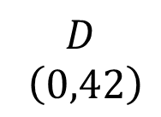

Quadrilateral Angles
SIC_87
$$C \left(6,50\right)$$
(Not to scale)
$$D$$
$$\left(0,42\right)$$
$$B \left(62,8\right)$$
$$A \left(6,0\right)$$
S
Determine the angles in the quadrilateral.
Notes:
X=7, y=4

Slide 32

Quadrilateral Angles
SIC_87
$$C \left(3,25\right)$$
(Not to scale)
$$D$$
$$\left(0,21\right)$$
$$B \left(31,4\right)$$
$$A \left(3,0\right)$$
T
Determine the angles in the quadrilateral.
Notes:
X=4, y=3

Slide 33
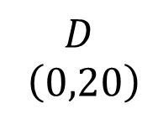

Quadrilateral Angles
SIC_87
$$C \left(4,26\right)$$
(Not to scale)
$$D$$
$$\left(0,20\right)$$
$$B \left(34,6\right)$$
$$A \left(4,0\right)$$
U
Determine the angles in the quadrilateral.
Notes:
X=5, y=1

Slide 34
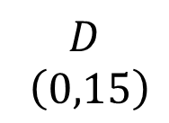

Quadrilateral Angles
SIC_87
$$C \left(6,29\right)$$
(Not to scale)
$$D$$
$$\left(0,15\right)$$
$$B \left(41,14\right)$$
$$A \left(6,0\right)$$
V
Determine the angles in the quadrilateral.
Notes:
X=5, y=2

Slide 35
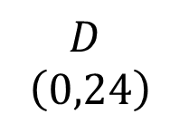

Quadrilateral Angles
SIC_87
$$C \left(6,34\right)$$
(Not to scale)
$$D$$
$$\left(0,24\right)$$
$$B \left(46,10\right)$$
$$A \left(6,0\right)$$
W
Determine the angles in the quadrilateral.
Notes:
X=5, y=3

Slide 36
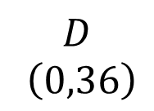

Quadrilateral Angles
SIC_87
$$C \left(4,41\right)$$
(Not to scale)
$$D$$
$$\left(0,36\right)$$
$$B \left(49,5\right)$$
$$A \left(4,0\right)$$
X
Determine the angles in the quadrilateral.
Notes:
X=5, y=4

